Slide 1
Think Like An Attacker: Web Security
Haz Parakrama
haz@jayasun.com

Slide 2
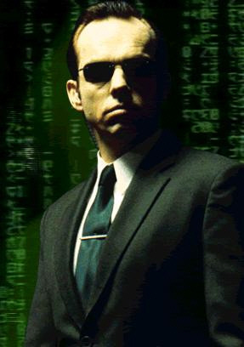
Who is a Potential Attacker?
EVERYONE
Authenticated users
Anonymous individuals
Other applications

Slide 3
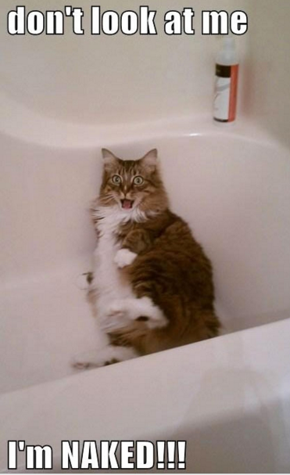
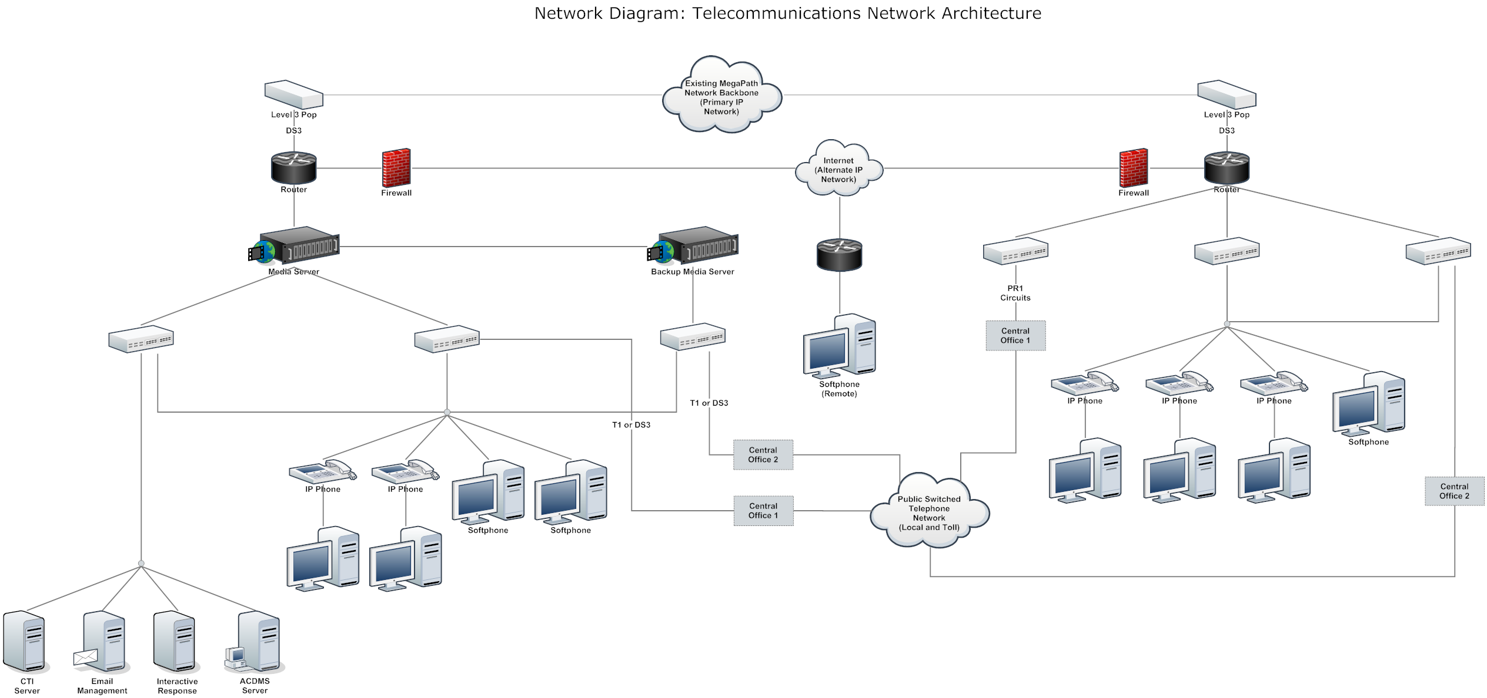
Always Feel Exposed

Slide 4
BASICS: TCP/IP and HTTP

Slide 5
BASICS: Cookies
HTTP is stateless
Use cookies to maintain state

Slide 6
Basics: Cookies
Key-Value string pairs
Received in HTTP Response by “Set-Cookie” Header Set-Cookie: WMF-Last-Access=15-Jun-2015
Sent in HTTP Request with “Cookie” Header Cookie: GeoIP=US:Lenexa:38.9499:-94.7453:v4
Stored and maintained by browser

Slide 7
Basics: Cookies
Property | Example | How Browser Handles Property
Domain | *.wikipedia.org | Only transmits cookie if HTTP Request is to this domain.
Path | / | Only transmits cookie if HTTP Request is also to this path.
Expires | Fri, 17 Jul 2015 00:00:00 GMT | Deletes the cookie from the browser at this date and time.
HttpOnly |  | Prevents cookie from being accessed via javascript.
Secure |  | Only transmits cookie if HTTP Request is over SSL.

Slide 8
Demo Application

Slide 9
Basic Forms Authentication

Slide 10

Protect Your Cookies
Set HttpOnly Flag

Slide 11
Problems with Forms Auth. Cookies
Sensitive user information stored on cookie

Slide 12
Sessions
Information stored on server
Identified by cookie containing session key

Slide 13
Session Hijacking
Attacker obtains session cookie

Slide 14
Session Hijacking: Session Key Reuse
ASP.NET reuses session keys if session cookie is provided

Slide 15
Session Hijacking: Session Key Reuse
ASP.NET reuses session keys if session cookie is provided
Therefore, always:
Clear session cookies from browser when redirecting to login page

Slide 16
Sessions: Remember Me
Logging in every hour is annoying
Use persistent session cookie which expires after a time

Slide 17
Sessions: Remember ME
Use custom session database
Store session data, keyed by session ID
Store session ID in persistent cookie (expiring after a time)
To authenticate a request:
Extract session ID from cookie
Load session data from database

Slide 18
Sessions: Remember ME – Preventing Hijacking
Use custom session database
Store session data, keyed by session ID
Store a token associated with a session
Store session ID in persistent cookie (expiring after a time)
Store token in the cookie as well
To authenticate a request:
Extract session ID and token from cookie
Load session data from database
Based on session ID and token
If session exists, update token in database and cookie
Otherwise, kill session, delete token, force re-login

Slide 19
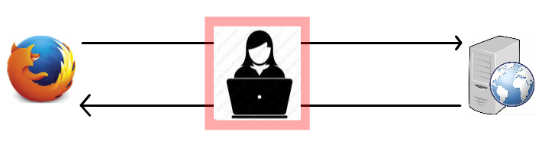
Man in the Middle
Sniff HTTP requests/responses and store data
Tamper with requests and send malicious data to server
Tamper with responses and send malicious data to user

Slide 20
Man in the Middle: Demo

Slide 21
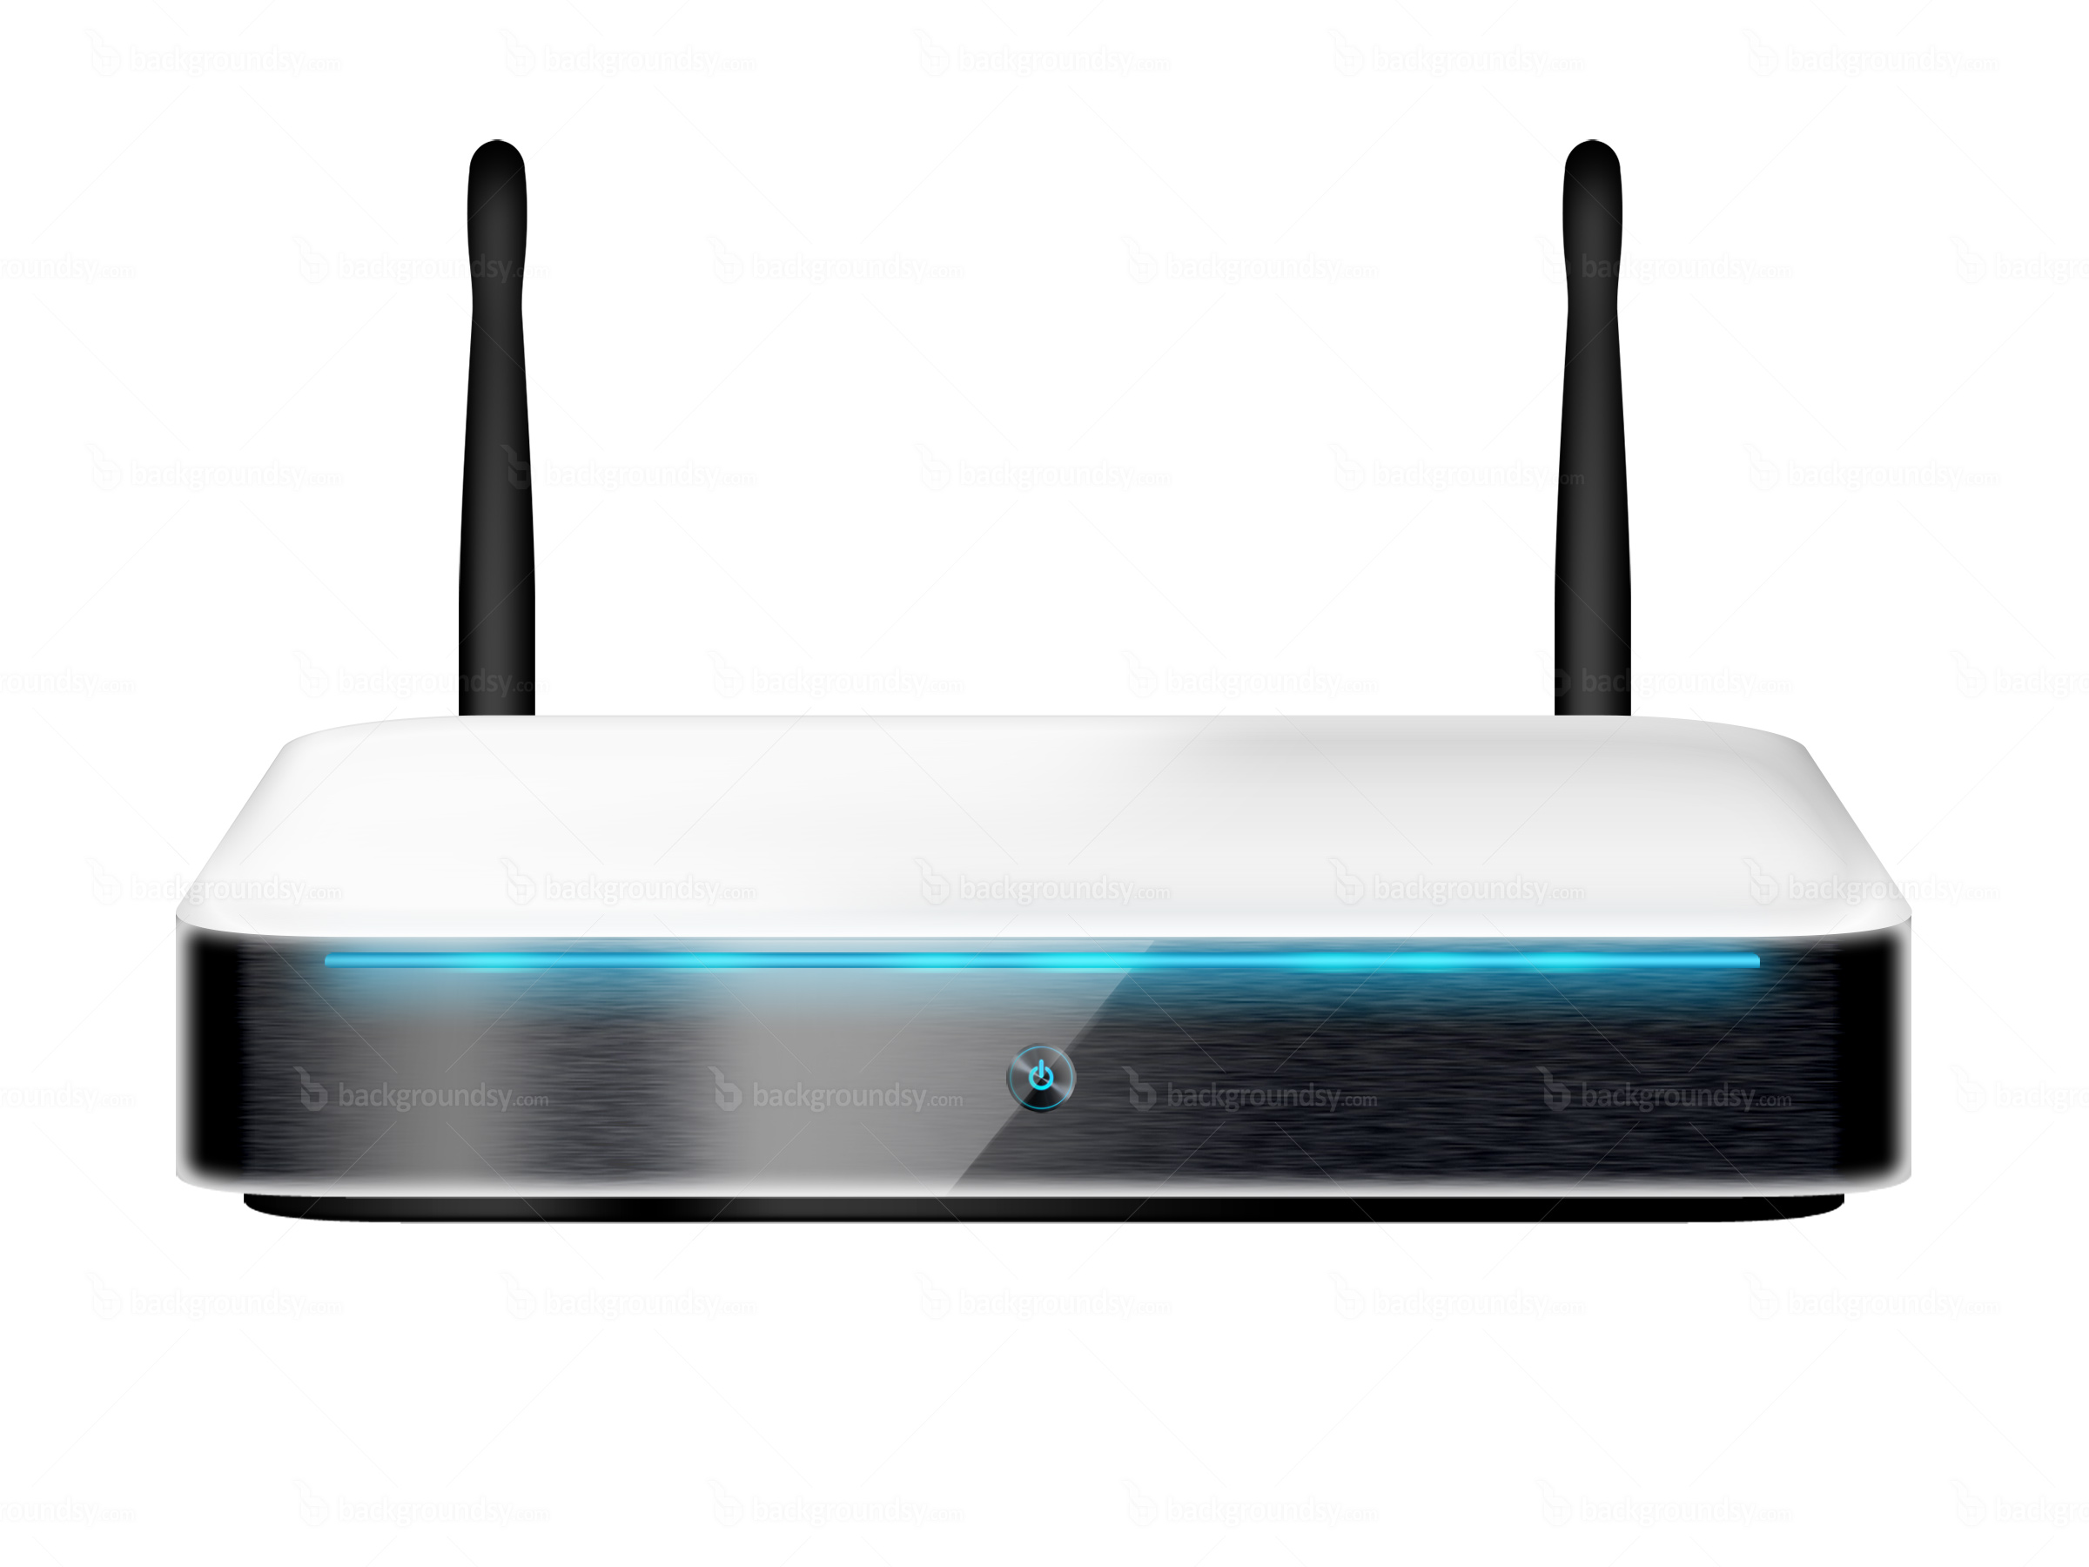
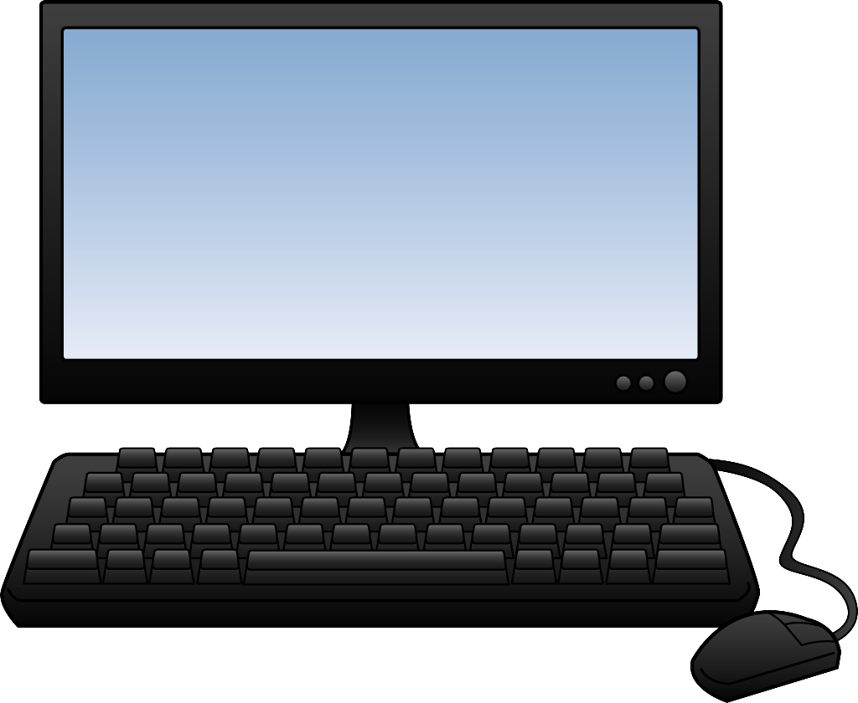
MAN IN THE MIDDLE: ARP POISONING
“Who is 192.168.0.109?”
“I am 192.168.0.109”

Slide 22
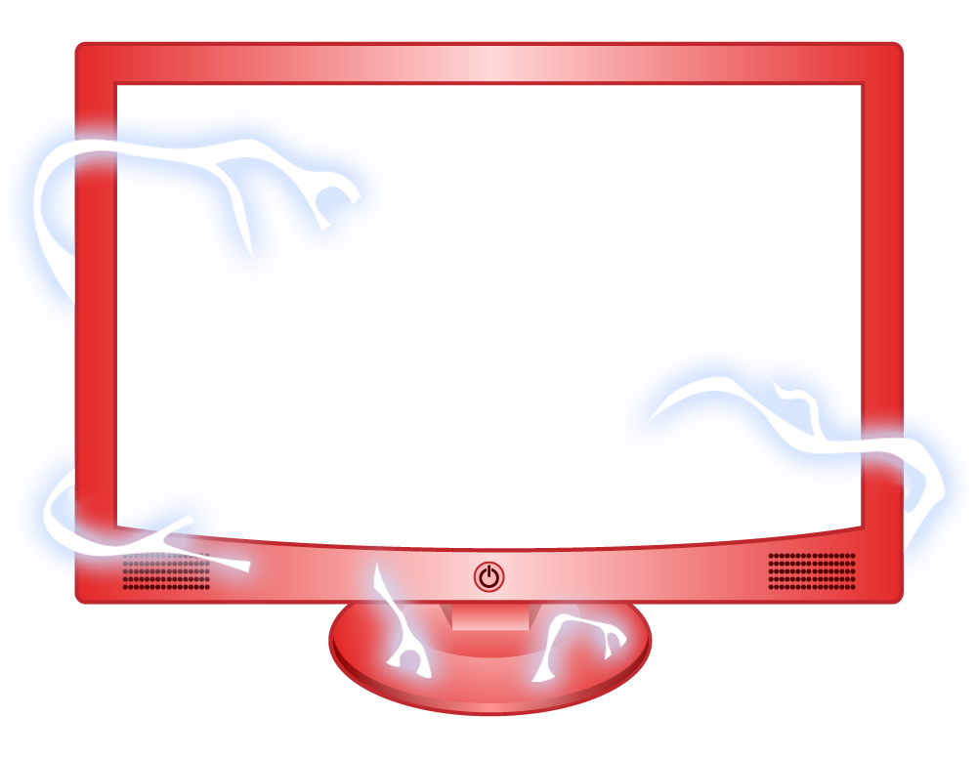
MAN IN THE MIDDLE: ARP POISONING
“I am 192.168.0.1”
“I am 192.168.0.109”

Slide 23
MAN IN THE MIDDLE: ARP POISONING

Slide 24
SSL
Encrypts communication between user and server
Man in the middle can’t decrypt traffic

Slide 25
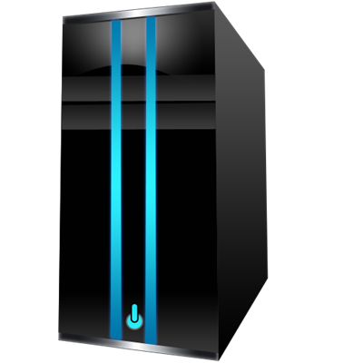

Man in the Middle: SSLSTRIP
HTTP
HTTPS

Slide 26
Defending Against sslstrip
Educate the user
Have browsers notify when you’re NOT using SSL?

Slide 27
API Vulnerabilities
Authenticate requests to the API as well

Slide 28
Api Vulnerabilities
Data Access Rights
Make sure the user has rights to the data requested, not just to the API call
Protect personal information
Only return what you need to return
NEVER return personal information of other users, whether displayed on the page or not.

Slide 29
Cross Site Scripting (XSS)
Attacker is allowed to inject javascript

Slide 30
Protecting Against XSS
HTML Encoding
Encode before saving in the database
Encode before displaying on the page

Slide 31
Cross Site Request Forgery (CSRF)
Making authenticated requests for a user without user’s permission
Baiting user to:
Click a link to perform an action
Load a malicious page

Slide 32
Protecting Against CSRF
Use anti-forgery token
MVC: [ValidateAntiForgeryToken] Attribute
When rendering page
Set anti-forgery token cookie
When processing request
Validate anti-forgery token before executing action
Never expose critical actions without an anti-forgery token

Slide 33
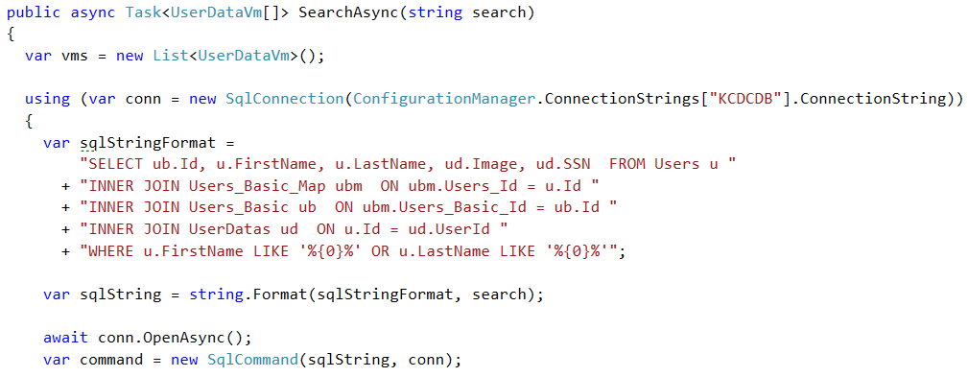
SQL Injection
OWASP’s #1 vulnerability on the web
Happens when you do this:

Slide 34
Sql Injection: Tools
Havij
Burp
sqlmap

Slide 35
Preventing SQL Injection
Parameterize your SQL
Use ORMs

Slide 36
Preventing SQL Injection
Limit database access for application user
Hide SQL query errors from end user

Slide 37
Securing Your Internal Network
Use SSL
Use client certificates
Web Svc 1
DB 1
App A
Web Svc 2
App B
Web Svc 3
DB 2

Slide 38
Securing Your Internal Network
Use SSL
Use client certificates
Web Svc 1
DB 1
App A
Web Svc 2
App B
Web Svc 3
DB 2

Slide 39

Securing Your Internal Network
Use SSL
Use client certificates
Web Svc 1
DB 1
App A
Web Svc 2
App B
Web Svc 3
DB 2

Slide 40
Secure Everything You Can
NEVER expose sequential identifiers
Encrypt integer IDs before returning to the user
Use GUIDs instead
NEVER return errors and stack traces to end user
NEVER rely on client-side validation
Treat ALL input as untrusted
Query string parameters, form input, binary file uploads, EVEN YOUR OWN DATABASE
Encrypt sensitive information in your database
Think like an attacker

Slide 41
Questions?
Slides available on GitHub
https://github.com/hazparakrama/
Haz Parakrama haz@jayasun.com

